Slide 1
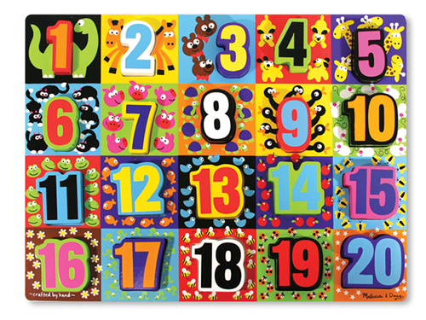
Module 5
Numbers 10-20 and
Counting to 100
(Lessons 15-24)

Slide 2
Lesson Links
Click on the lesson you want to go to!
(You must be in Slide Show/Presentation Mode.)
Lesson 15 Lesson 20 Lesson 16 Lesson 21 Lesson 17 Lesson 22 Lesson 18 Lesson 23 Lesson 19 Lesson 24

Slide 3


Lesson 15
I can count up and down by tens to 100 the Say Ten way and the regular way.

Slide 4


Module 5, Lesson 15
Fluency
Write Teen Numbers with Circular Configurations
On your personal white board, write the number of stars that you see. Say the number the Say Ten Way. Say the number the regular way.

Slide 5
Module 5, Lesson 15
Fluency
Write Teen Numbers with Circular Configurations
On your personal white board, write the number of stars that you see. Say the number the Say Ten Way. Say the number the regular way.

Slide 6
Module 5, Lesson 15
Fluency
Write Teen Numbers with Circular Configurations
On your personal white board, write the number of stars that you see. Say the number the Say Ten Way. Say the number the regular way.

Slide 7
Module 5, Lesson 15
Fluency
Write Teen Numbers with Circular Configurations
On your personal white board, write the number of stars that you see. Say the number the Say Ten Way. Say the number the regular way.

Slide 8
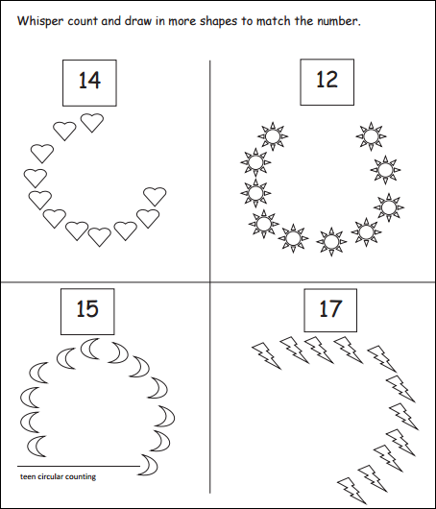

Module 5, Lesson 15
Fluency
Teen Circular Counting
Say each number the regular way and the Say Ten Way. Whisper-count as you draw more shapes to match the number.

Slide 9

Module 5, Lesson 15
Fluency
Hide Zero for Teen Numbers
Say the number. Say the number the Say Ten Way. (click)
1 0
5

Slide 10
Module 5, Lesson 15
Fluency
Hide Zero for Teen Numbers
Say the number. Say the number the Say Ten Way. (click)
1 0
1

Slide 11
Module 5, Lesson 15
Fluency
Hide Zero for Teen Numbers
Say the number. Say the number the Say Ten Way. (click)
1 0
9

Slide 12
Module 5, Lesson 15
Fluency
Hide Zero for Teen Numbers
Say the number. Say the number the Say Ten Way. (click)
1 0
3

Slide 13
Module 5, Lesson 15
Fluency
Hide Zero for Teen Numbers
Say the number. Say the number the Say Ten Way. (click)
1 0
6

Slide 14
Module 5, Lesson 15
Fluency
Hide Zero for Teen Numbers
Say the number. Say the number the Say Ten Way. (click)
1 0
2

Slide 15
Module 5, Lesson 15
Fluency
Hide Zero for Teen Numbers
Say the number. Say the number the Say Ten Way. (click)
1 0
7

Slide 16
Module 5, Lesson 15
Fluency
Hide Zero for Teen Numbers
Say the number. Say the number the Say Ten Way. (click)
1 0
4

Slide 17
Module 5, Lesson 15
Fluency
Hide Zero for Teen Numbers
Say the number. Say the number the Say Ten Way. (click)
1 0
8

Slide 18

Application Problem
Module 5, Lesson 15
Mr. Perry is decorating donuts. He puts 14 little dots of chocolate in a circle. Show him an idea about how to put the 14 dots in a circle on his donut. Use your cubes first and then draw the chocolate dots on. Show the total number of dots of chocolate with a number bond and your hide zero cards.

Slide 19

Module 5, Lesson 15
Let’s count all the beads on my Rekenrek!
Click here for a virtual Rekenrek!
(Click on the + sign to add rows of beads.)

Slide 20


Module 5, Lesson 15
Lay your 10-frame cards out on your desk like mine!
Let’s count them
the Say Ten way and then the regular way!

Slide 21

Module 5, Lesson 15
I’m will say a number the Say Ten way. Pull down that many cards in front of you.
3 tens!

Slide 22

Module 5, Lesson 15
8 tens!

Slide 23


Module 5, Lesson 15
6 tens!

Slide 24

Module 5, Lesson 15
9 tens!

Slide 25

Module 5, Lesson 15
4 tens!

Slide 26
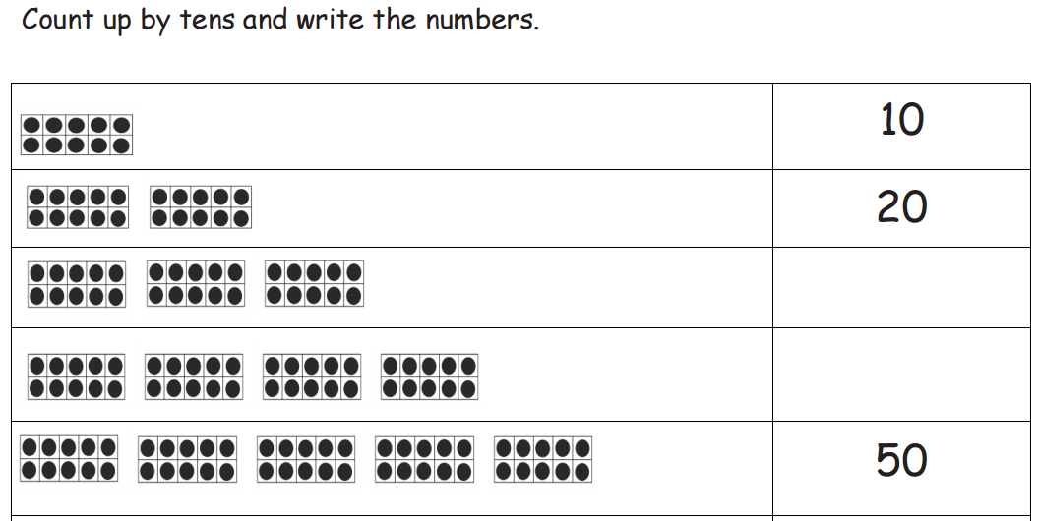

Slide 27
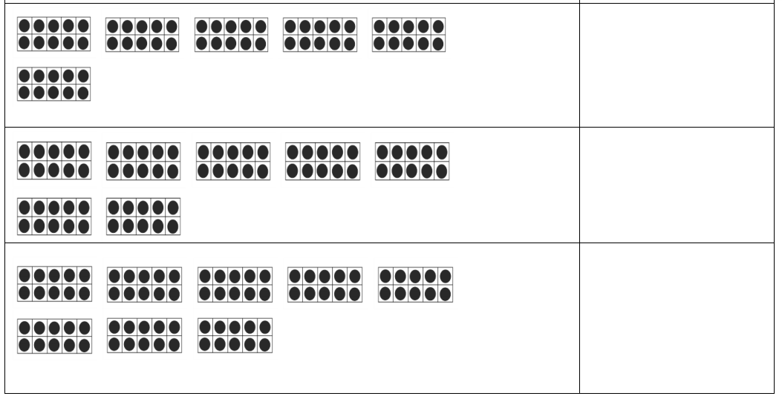

Slide 28
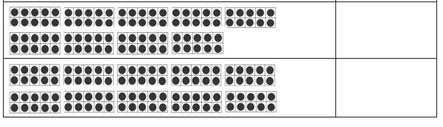

Slide 29
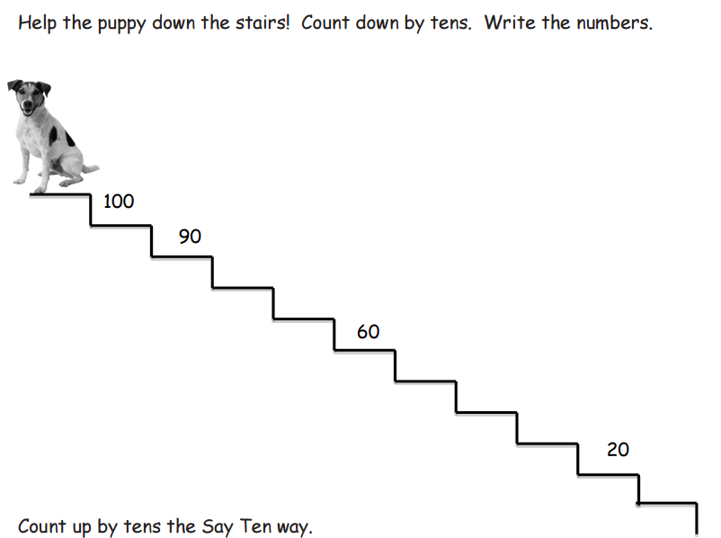

Slide 30
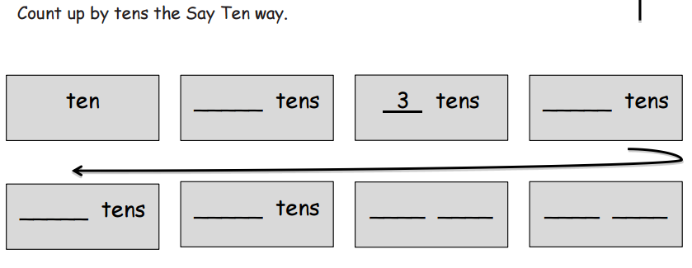

Slide 31

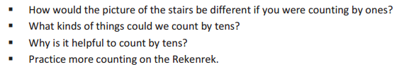

Debrief

Slide 32
Lesson 16
I can count within tens by ones.

Slide 33
Module 5, Lesson 16
Fluency
Hide Zero for Teen Numbers
Place the 10 Hide Zero card in the middle. One partner gets 4 of the cards numbered 1-9, and the other partner gets the remaining 5 cards. The player with 5 cards puts one of his cards down on the 10. The other partner counts out that many counters. Switch roles!

Slide 34

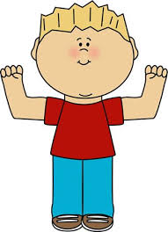
Module 5, Lesson 16
Fluency
Count by Tens the Say Ten Way
Say the number you see. Say the number the Say Ten Way.

Slide 35
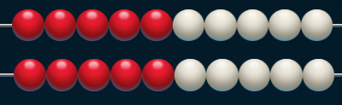
Module 5, Lesson 16
Fluency
Count by Tens the Say Ten Way
Say the number you see. Say the number the Say Ten Way.

Slide 36
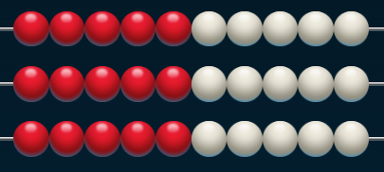
Module 5, Lesson 16
Fluency
Count by Tens the Say Ten Way
Say the number you see. Say the number the Say Ten Way.

Slide 37
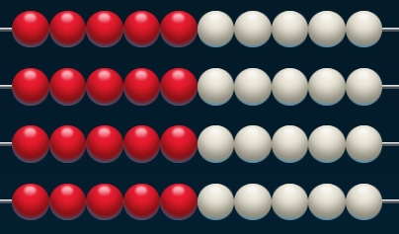
Module 5, Lesson 16
Fluency
Count by Tens the Say Ten Way
Say the number you see. Say the number the Say Ten Way.

Slide 38
Module 5, Lesson 16
Fluency
Count by Tens the Say Ten Way
Say the number you see. Say the number the Say Ten Way.

Slide 39
Module 5, Lesson 16
Fluency
Count by Tens the Say Ten Way
Say the number you see. Say the number the Say Ten Way.

Slide 40
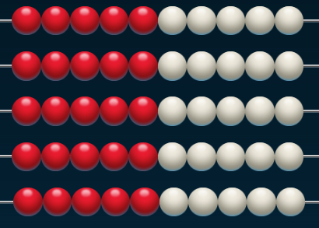
Module 5, Lesson 16
Fluency
Count by Tens the Say Ten Way
Say the number you see. Say the number the Say Ten Way.

Slide 41
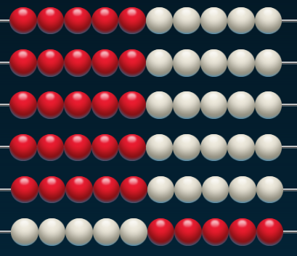
Module 5, Lesson 16
Fluency
Count by Tens the Say Ten Way
Say the number you see. Say the number the Say Ten Way.

Slide 42
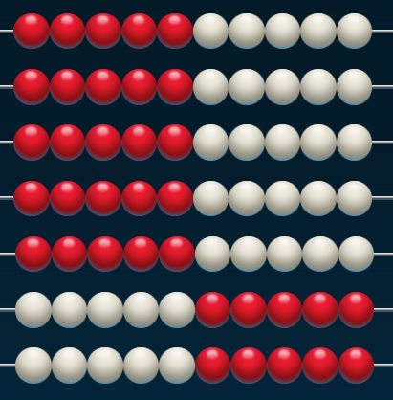
Module 5, Lesson 16
Fluency
Count by Tens the Say Ten Way
Say the number you see. Say the number the Say Ten Way.

Slide 43
Module 5, Lesson 16
Fluency
Count by Tens the Say Ten Way
Say the number you see. Say the number the Say Ten Way.

Slide 44
Module 5, Lesson 16
Fluency
Count by Tens the Say Ten Way
Say the number you see. Say the number the Say Ten Way.

Slide 45
Module 5, Lesson 16
Fluency
Count by Tens the Say Ten Way
Say the number you see. Say the number the Say Ten Way.

Slide 46
Module 5, Lesson 16
Fluency
Count by Tens the Say Ten Way
Say the number you see. Say the number the Say Ten Way.

Slide 47
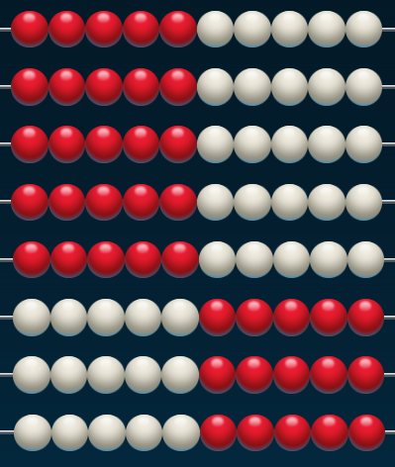
Module 5, Lesson 16
Fluency
Count by Tens the Say Ten Way
Say the number you see. Say the number the Say Ten Way.

Slide 48
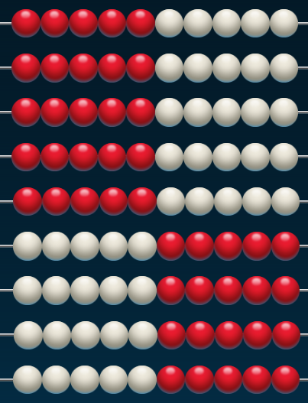
Module 5, Lesson 16
Fluency
Count by Tens the Say Ten Way
Say the number you see. Say the number the Say Ten Way.

Slide 49
Module 5, Lesson 16
Fluency
Count by Tens the Say Ten Way
Say the number you see. Say the number the Say Ten Way.

Slide 50
Module 5, Lesson 16
Fluency
Count by Tens the Say Ten Way
Say the number you see. Say the number the Say Ten Way.

Slide 51
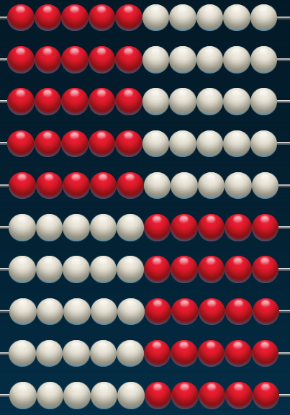
Module 5, Lesson 16
Fluency
Count by Tens the Say Ten Way
Say the number you see. Say the number the Say Ten Way.

Slide 52

Module 5, Lesson 16
Fluency
Count with Ten-Frame Cards
Place a ten-frame card in front of you. Say the number.

Slide 53
Module 5, Lesson 16
Fluency
Count with Ten-Frame Cards
Place another ten-frame card in front of you. Say the number the Say Ten Way.

Slide 54
Module 5, Lesson 16
Fluency
Count with Ten-Frame Cards
Place another ten-frame card in front of you. Say the number the Say Ten Way.

Slide 55
Module 5, Lesson 16
Fluency
Count with Ten-Frame Cards
Place another ten-frame card in front of you. Say the number the Say Ten Way.

Slide 56
Module 5, Lesson 16
Fluency
Count with Ten-Frame Cards
Place another ten-frame card in front of you. Say the number the Say Ten Way.

Slide 57
Module 5, Lesson 16
Fluency
Count with Ten-Frame Cards
Place another ten-frame card in front of you. Say the number the Say Ten Way.

Slide 58
Module 5, Lesson 16
Fluency
Count with Ten-Frame Cards
Place another ten-frame card in front of you. Say the number the Say Ten Way.

Slide 59
Module 5, Lesson 16
Fluency
Count with Ten-Frame Cards
Place another ten-frame card in front of you. Say the number the Say Ten Way.

Slide 60
Module 5, Lesson 16
Fluency
Count with Ten-Frame Cards
Place another ten-frame card in front of you. Say the number the Say Ten Way.

Slide 61
Module 5, Lesson 16
Fluency
Count with Ten-Frame Cards
Place another ten-frame card in front of you. Say the number the Say Ten Way.

Slide 62
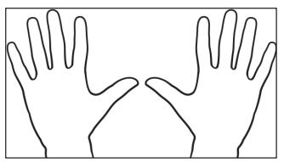

Application Problem
Module 5, Lesson 16
The students in Pre-Kindergarten are making handprints. 7 students are putting their handprints on a poster board. How many fingers will show in the poster? Use your handprint cards to help you find out.

Slide 63


Module 5, Lesson 16
Use your counters to count from 0 to 9. When you get to 9, raise your hand for a 10-frame. Remove your counters. Then, count from 10 to 19. When you get to 19, raise your hand for another 10-frame. Remove your counters. Then, count from 20 to 29…
FUN!

Slide 64

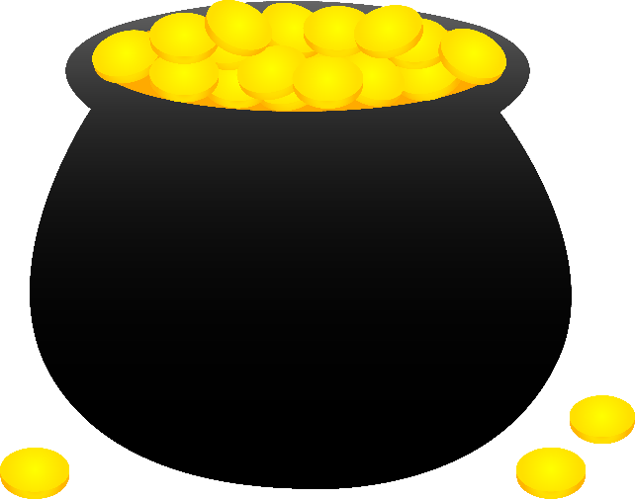
Module 5, Lesson 16
I have created a path on the floor. Let’s pretend it leads us to a magic pot, and if you reach it you can wish for anything you want! But to get there, you have to count in order from 30 to 39 or 40 to 49 or 50 to? From 60 to? Who would like to go first?
Start at
30

Slide 65
Module 5, Lesson 16
Who would like to go next?
Start at
50

Slide 66
Module 5, Lesson 16
Who would like to go next?
Start at
60

Slide 67
Module 5, Lesson 16
Who would like to go next?
Start at
80

Slide 68
Module 5, Lesson 16
Who would like to go next?
Start at
90

Slide 69
Module 5, Lesson 16
I’m going to remove 5 stepping stones. Now, you will have
to count from 35 to 39 or 45 to 49 or 55 to? Who would like
to go first?
Start at
35

Slide 70
Module 5, Lesson 16
Who would like to go next?
Start at
55

Slide 71
Module 5, Lesson 16
Who would like to go next?
Start at
75

Slide 72
Module 5, Lesson 16
Who would like to go next?
Start at
85

Slide 73
Module 5, Lesson 16
I’m going to put two stepping stones back. Now, you will start counting at 23 or 33 or 43! Who would like to go first?
Start at
23

Slide 74
Module 5, Lesson 16
Who would like to go next?
Start at
53

Slide 75
Module 5, Lesson 16
Who would like to go next?
Start at
83

Slide 76
Module 5, Lesson 16
Who would like to go next?
Start at
93

Slide 77
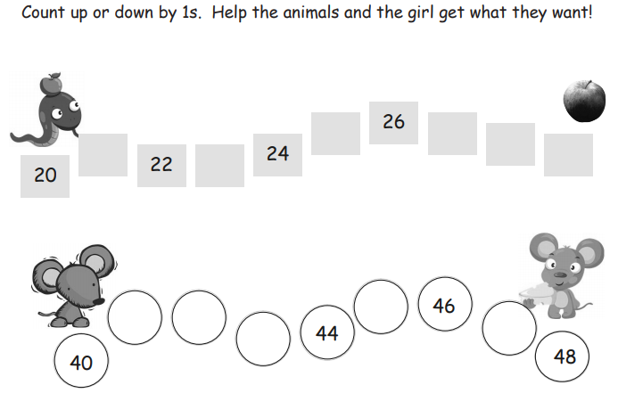

Slide 78
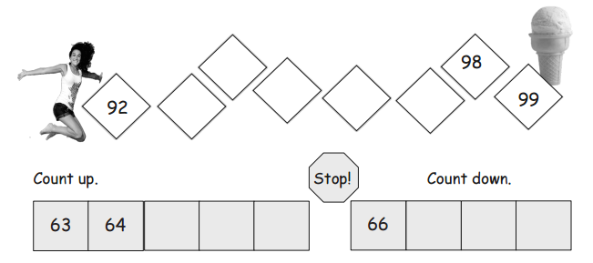

Slide 79
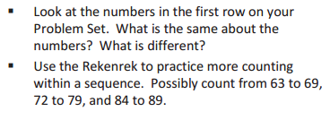
Debrief

Slide 80
Lesson 17
I can count across tens when counting by ones through 40.

Slide 81

Application Problem
Module 5, Lesson 17
Sammy’s mom has 10 apples in a bag. Some are red and some are green. What might be the number of each color apple in her bag? There is more than one possible answer. Show your answers with number bonds. Label the parts as R and G.

Slide 82
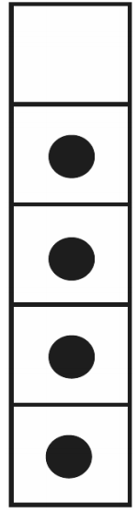


Module 5, Lesson 17
Fluency
5-Frame Flashes
How many dots do you see? How many more to make 5? Say the addition sentence.

Slide 83
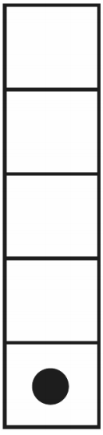
Module 5, Lesson 17
Fluency
5-Frame Flashes
How many dots do you see? How many more to make 5? Say the addition sentence.

Slide 84
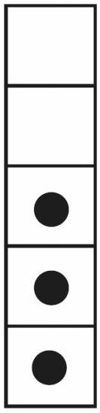
Module 5, Lesson 17
Fluency
5-Frame Flashes
How many dots do you see? How many more to make 5? Say the addition sentence.

Slide 85
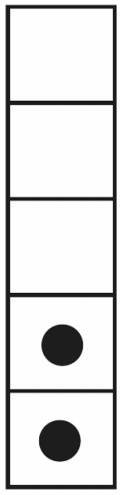
Module 5, Lesson 17
Fluency
5-Frame Flashes
How many dots do you see? How many more to make 5? Say the addition sentence.

Slide 86
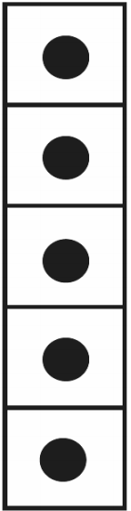
Module 5, Lesson 17
Fluency
5-Frame Flashes
How many dots do you see? How many more to make 5? Say the addition sentence.

Slide 87
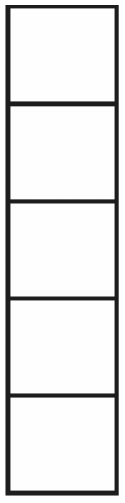
Module 5, Lesson 17
Fluency
5-Frame Flashes
How many dots do you see? How many more to make 5? Say the addition sentence.

Slide 88
Module 5, Lesson 17
Fluency
5-Frame Flashes
How many dots do you see? How many more to make 5? Say the addition sentence.

Slide 89
Module 5, Lesson 17
Fluency
5-Frame Flashes
How many dots do you see? How many more to make 5? Say the addition sentence.

Slide 90


Module 5, Lesson 17
Fluency
Count Out Teen Numbers
Count 13 items out of your bag. Separate them into two parts – one part with 10 and another part. Write the number on your personal white board.

Slide 91
Module 5, Lesson 17
Fluency
Count Out Teen Numbers
Count 17 items out of your bag. Separate them into two parts – one part with 10 and another part. Write the number on your personal white board.

Slide 92
Module 5, Lesson 17
Fluency
Count Out Teen Numbers
Count 15 items out of your bag. Separate them into two parts – one part with 10 and another part. Write the number on your personal white board.

Slide 93
Module 5, Lesson 17
Fluency
Count Out Teen Numbers
Count 19 items out of your bag. Separate them into two parts – one part with 10 and another part. Write the number on your personal white board.

Slide 94
Module 5, Lesson 17
Fluency
Count Out Teen Numbers
Count 16 items out of your bag. Separate them into two parts – one part with 10 and another part. Write the number on your personal white board.

Slide 95

Module 5, Lesson 17
Fluency
Count Within Tens
Let’s count starting at 20. We will count to 29. Pay attention! I may have you change directions!
(Repeat with 50-59 and 80-89.)

Slide 96
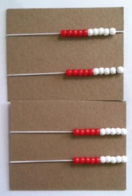

Module 5, Lesson 15
Put your Rekenrek together
with your partner’s.
Move all your beads to the right.
Partner A, move the beads as you both whisper count.
Partner B, move the beads on the next row as you both whisper count. What is the first number we will say? Let’s count the regular way!
Partner A, it’s your turn! Move one bead on the next row. How do we say it the Say Ten way? Say it the regular way. Keep counting the regular way.
Partner B, it’s your turn! Move one bead on the last row. How do we say it the Say Ten way? Say it the regular way. Keep counting the regular way.
Click here for a virtual Rekenrek!

Slide 97
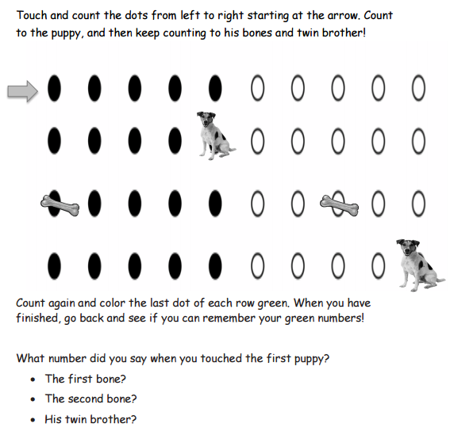

Slide 98
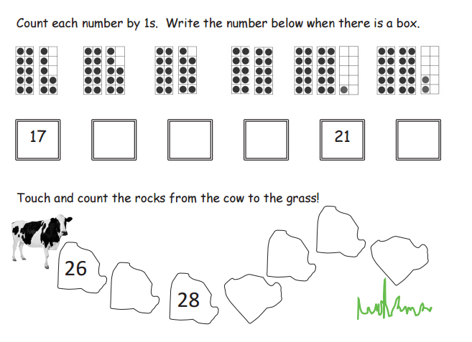

Slide 99
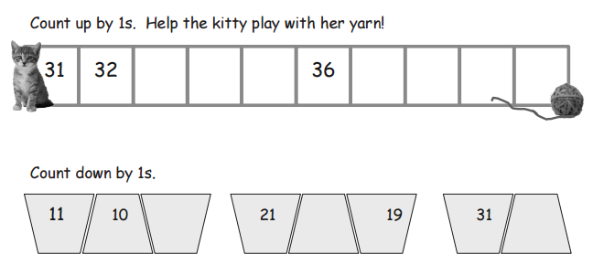

Slide 100
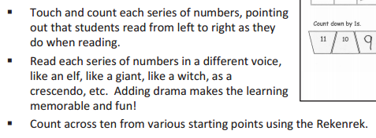
Debrief

Slide 101
Lesson 18
I can count across tens by ones to 100 with and without objects.

Slide 102

Application Problem
Module 5, Lesson 18
Susan is putting 9 flowers in 2 vases. Draw a picture to show a way she might do that. Make a number bond and a number sentence to match your idea.

Slide 103
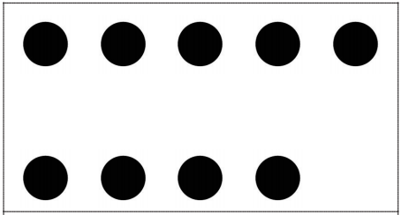

Module 5, Lesson 18
Fluency
Ten-Frame Flashes
How many dots do you see? How many more does it need to be 10?

Slide 104

Module 5, Lesson 18
Fluency
Ten-Frame Flashes
How many dots do you see? How many more does it need to be 10?

Slide 105
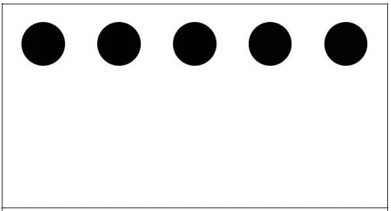
Module 5, Lesson 18
Fluency
Ten-Frame Flashes
How many dots do you see? How many more does it need to be 10?

Slide 106
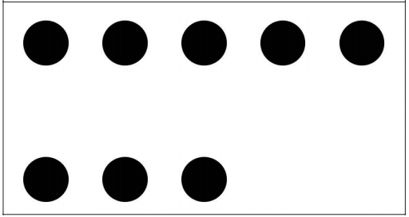
Module 5, Lesson 18
Fluency
Ten-Frame Flashes
How many dots do you see? How many more does it need to be 10?

Slide 107
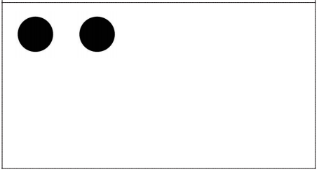
Module 5, Lesson 18
Fluency
Ten-Frame Flashes
How many dots do you see? How many more does it need to be 10?

Slide 108
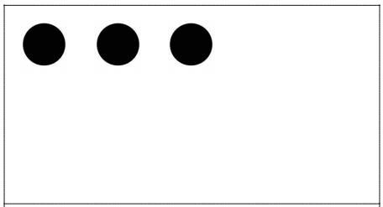
Module 5, Lesson 18
Fluency
Ten-Frame Flashes
How many dots do you see? How many more does it need to be 10?

Slide 109
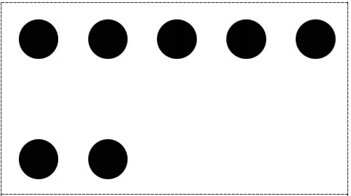
Module 5, Lesson 18
Fluency
Ten-Frame Flashes
How many dots do you see? How many more does it need to be 10?

Slide 110
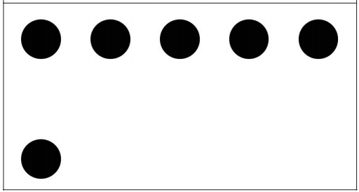
Module 5, Lesson 18
Fluency
Ten-Frame Flashes
How many dots do you see? How many more does it need to be 10?

Slide 111
Module 5, Lesson 18
Fluency
Ten-Frame Flashes
How many dots do you see? How many more does it need to be 10?

Slide 112
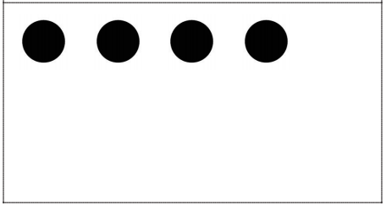
Module 5, Lesson 18
Fluency
Ten-Frame Flashes
How many dots do you see? How many more does it need to be 10?

Slide 113
Module 5, Lesson 18
Fluency
Ten-Frame Flashes
How many dots do you see? How many more does it need to be 10?

Slide 114
Module 5, Lesson 18
Fluency
Ten-Frame Flashes
How many dots do you see? How many more does it need to be 10?

Slide 115
Module 5, Lesson 18
Fluency
Ten-Frame Flashes
How many dots do you see? How many more does it need to be 10?

Slide 116
Module 5, Lesson 18
Fluency
Ten-Frame Flashes
How many dots do you see? How many more does it need to be 10?

Slide 117
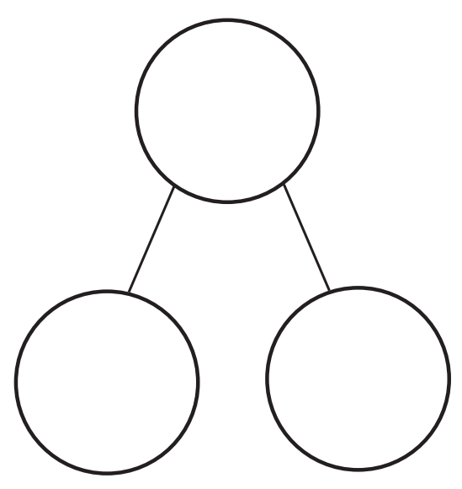



Module 5, Lesson 18
Fluency
Teen Number Bonds
Say the larger part. Say the smaller part. Count the whole, or total, with me.

Slide 118


Module 5, Lesson 18
Fluency
Teen Number Bonds
Say the larger part. Say the smaller part. Count the whole, or total, with me.

Slide 119


Module 5, Lesson 18
Fluency
Teen Number Bonds
Say the larger part. Say the smaller part. Count the whole, or total, with me.

Slide 120


Module 5, Lesson 18
Fluency
Teen Number Bonds
Say the larger part. Say the smaller part. Count the whole, or total, with me.

Slide 121


Module 5, Lesson 18
Fluency
Teen Number Bonds
Say the larger part. Say the smaller part. Count the whole, or total, with me.

Slide 122


Module 5, Lesson 18
Fluency
Teen Number Bonds
Say the larger part. Say the smaller part. Count the whole, or total, with me.

Slide 123
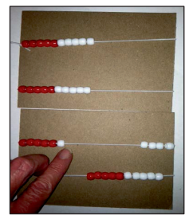
Module 5, Lesson 18
Fluency
Count on the Rekenrek
Put your Rekenrek together with your partner’s. Whisper count with your partner up to 40 on your Rekenrek. Take turns moving the beads with each new row. Buzz before you say the first number of each row.

Slide 124

Module 5, Lesson 18
Let’s count by ten to 40 on the Rekenrek, then count by ones to 50.
(Go back and forth across 10 from different starting points within 100.)
Click here for a virtual Rekenrek!

Slide 125


Module 5, Lesson 18
Place one more counter on the next 10-frame. Say the number the Say Ten way. Say it the regular way. What is one more than 60? Take one counter off. What is the number the Say Ten way? Say it the regular way.
Now, let’s count and show numbers a different way. Lay out 10-frame cards as we count the Say Ten way.
Place two empty 10-frames after 50. Count on from 50, placing one counter at a time as we say each number. Start the Say Ten way, then count the regular way.
Take away one more counter. What is the number the Say Ten way? Say the number the regular way.

Slide 126
Module 5, Lesson 18
Place one more counter on the next 10-frame. Say the number the Say Ten way. Say it the regular way. What is one more than 70? Take one counter off. What is the number the Say Ten way? Say it the regular way.
Place two empty 10-frames after 60. Count on from 60, placing one counter at a time as we say each number. Start the Say Ten way, then count the regular way.
Lay out 10-frame cards as we count the Say Ten way.
Take away one more counter. What is the number the Say Ten way? Say the number the regular way.

Slide 127
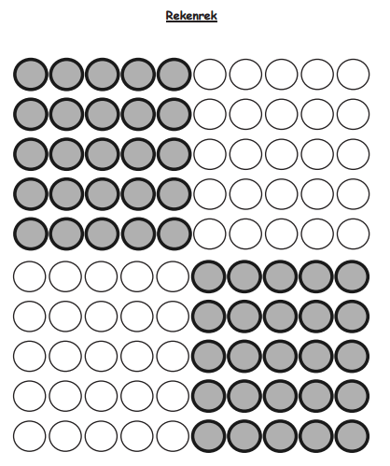
See Teacher’s
Directions.

Slide 128
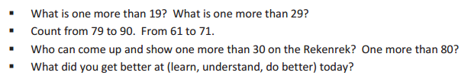
Debrief

Slide 129
Lesson 19
I can explore numbers on the Rekenrek.

Slide 130

Application Problem
Module 5, Lesson 19
The light is out, and it’s dark. Peter knows that he left 7 blue and green beads for his crafts on his desk. But he can’t see how many are blue or how many are green in the dark! Draw a picture to show what the colors of his beads might be when he turns on the light.

Slide 131


Module 5, Lesson 19
Fluency
Number Bonds of 7
Show ten beads only. Hide 3 beads behind your board. The total number of beads you see is…? Push 1 bead to the right to make 2 parts. Tell your partner the number bond. “Part ___, part ___, total 7.”

Slide 132

Module 5, Lesson 19
Fluency
Number Bonds of 7
Push another bead to the right to make 2 parts. Tell your partner the number bond. “Part ___, part ___, total 7.”

Slide 133

Module 5, Lesson 19
Fluency
Number Bonds of 7
Push another bead to the right to make 2 parts. Tell your partner the number bond. “Part ___, part ___, total 7.”

Slide 134

Module 5, Lesson 19
Fluency
Number Bonds of 7
Push another bead to the right to make 2 parts. Tell your partner the number bond. “Part ___, part ___, total 7.”

Slide 135

Module 5, Lesson 19
Fluency
Number Bonds of 7
Push another bead to the right to make 2 parts. Tell your partner the number bond. “Part ___, part ___, total 7.”

Slide 136

Module 5, Lesson 19
Fluency
Number Bonds of 7
Push another bead to the right to make 2 parts. Tell your partner the number bond. “Part ___, part ___, total 7.”

Slide 137
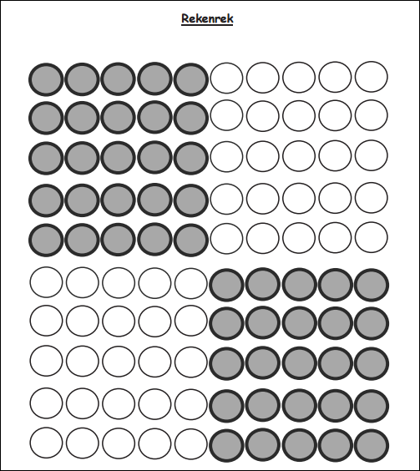

Module 5, Lesson 19
Fluency
Count to 100 by Ones
Count to 100 (or as high as you can) in 3 minutes by touching the beads on the Rekenrek dot paper. Say “buzz” after the last number of each row.

Slide 138
Module 5, Lesson 19
Fluency
Hide Zero for Numbers to 100
Say the number. Say the number the Say Ten Way. (click)
3 0
7

Slide 139
Module 5, Lesson 19
Fluency
Hide Zero for Numbers to 100
Say the number. Say the number the Say Ten Way. (click)
5 0
2

Slide 140
Module 5, Lesson 19
Fluency
Hide Zero for Numbers to 100
Say the number. Say the number the Say Ten Way. (click)
7 0
9

Slide 141
Module 5, Lesson 19
Fluency
Hide Zero for Numbers to 100
Say the number. Say the number the Say Ten Way. (click)
4 0
6

Slide 142
Module 5, Lesson 19
Fluency
Hide Zero for Numbers to 100
Say the number. Say the number the Say Ten Way. (click)
9 0
4

Slide 143
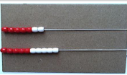

Module 5, Lesson 19
Show me 7 on your Rekenrek.
Take the bottom 10 beads out of hiding, and push them over to the left under your 7. How many beads are on the left?

Slide 144

Module 5, Lesson 19
Move 1 bead from your 7 over to the right. Total 16. What are the two parts?

Slide 145
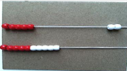
Module 5, Lesson 19
Move another bead. Total 15.
What are the two parts?

Slide 146

Module 5, Lesson 19
Move another! Keep going!

Slide 147
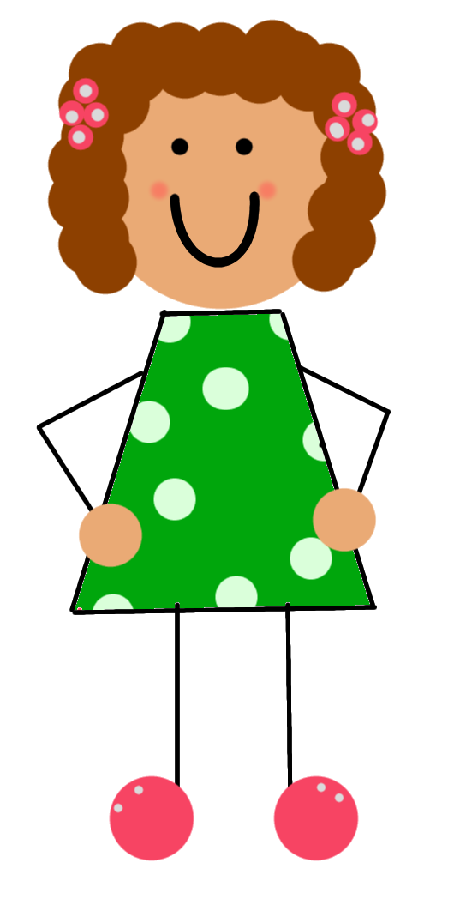

Module 5, Lesson 19
Get with your partner! Partner B, take all of your beads out of hiding and put your Rekenrek under your partner’s. Partner A, show ten seven again.
How many beads do you have now?
Say it the Say Ten way!
Move 1 bead from the 7 to the right.
How many beads are on the left?
Move a bead! Again!

Slide 148
Module 5, Lesson 19
Now, show two tens five. Move beads from the left to the right one bead at a time. Say each new number the Say Ten way!

Slide 149

Module 5, Lesson 19
Get with a third partner and make some more numbers!

Slide 150


Slide 151

Debrief

Slide 152
Lesson 20
I can use addition to compose teen numbers.

Slide 153


Module 5, Lesson 20
Fluency
Dot Cards of Seven
How many dots do you see? How did you see them in two parts? Say the number sentence. Who sees 7 in two different parts? Say the number sentence.

Slide 154

Module 5, Lesson 20
Fluency
Dot Cards of Seven
How many dots do you see? How did you see them in two parts? Say the number sentence. Who sees 7 in two different parts? Say the number sentence.

Slide 155

Module 5, Lesson 20
Fluency
Dot Cards of Seven
How many dots do you see? How did you see them in two parts? Say the number sentence. Who sees 7 in two different parts? Say the number sentence.

Slide 156

Module 5, Lesson 20
Fluency
Dot Cards of Seven
How many dots do you see? How did you see them in two parts? Say the number sentence. Who sees 7 in two different parts? Say the number sentence.

Slide 157

Module 5, Lesson 20
Fluency
Dot Cards of Seven
How many dots do you see? How did you see them in two parts? Say the number sentence. Who sees 7 in two different parts? Say the number sentence.

Slide 158

Module 5, Lesson 20
Fluency
Dot Cards of Seven
How many dots do you see? How did you see them in two parts? Say the number sentence. Who sees 7 in two different parts? Say the number sentence.

Slide 159

Module 5, Lesson 20
Fluency
Dot Cards of Seven
How many dots do you see? How did you see them in two parts? Say the number sentence. Who sees 7 in two different parts? Say the number sentence.

Slide 160

Module 5, Lesson 20
Fluency
Dot Cards of Seven
How many dots do you see? How did you see them in two parts? Say the number sentence. Who sees 7 in two different parts? Say the number sentence.

Slide 161

Module 5, Lesson 20
Fluency
Dot Cards of Seven
How many dots do you see? How did you see them in two parts? Say the number sentence. Who sees 7 in two different parts? Say the number sentence.

Slide 162

Module 5, Lesson 20
Fluency
Count Crossing Tens
Today, we’re going to work in groups of 3. Put your personal Rekenreks together, and count your beads. Say buzz after you finish a row. Partner A moves the beads of the first Rekenrek, Partner B moves the beads of the second, and Partner B moves the beads of the third. If you finish early, count again. This time, after the color changes, say buzz.

Slide 163


Module 5, Lesson 20
Fluency
Group Tens and Ones
Say the number of objects that you see.
Say the number the Say Ten Way.

Slide 164


Module 5, Lesson 20
Fluency
Group Tens and Ones
Say the number of objects that you see.
Say the number the Say Ten Way.

Slide 165

Module 5, Lesson 20
Fluency
Group Tens and Ones
Say the number of objects that you see.
Say the number the Say Ten Way.

Slide 166
Module 5, Lesson 20
Fluency
Group Tens and Ones
Say the number of objects that you see.
Say the number the Say Ten Way.

Slide 167

Module 5, Lesson 20
Fluency
Group Tens and Ones
Say the number of objects that you see.
Say the number the Say Ten Way.

Slide 168

Module 5, Lesson 20
Fluency
Group Tens and Ones
Say the number of objects that you see.
Say the number the Say Ten Way.

Slide 169


Application Problem
Module 5, Lesson 20
Each student got 6 colored pencils and 4 regular pencils. How many pencils did each student get? Draw a picture, an number bond, and write a number sentence, too.

Slide 170





Module 5, Lesson 20
Put 10 red beans in one part of the number bond.
Put 3 white beans in the other part.
What is 10 ones and 3 ones?
Say the number the Say Ten way.
Now count 13 beans into the place where we show the total or whole amount.

Slide 171

Module 5, Lesson 20
What’s another way we can show a number in two parts? Which way do you think is the clearest way?

Slide 172


Module 5, Lesson 20
Each way we show a number in two parts helps us to understand out number better. Addition is another way to do that.
10 + 3 = ___
13 = ___ + ___

Slide 173


Module 5, Lesson 20
Now count to find out how many beans you will put to show the total. It needs to match the amount in the parts.
Count that many beans into the place where you put your total.
Show 10 red beans and 5 white beans in the two parts.

Slide 174


Module 5, Lesson 20
What is another way to show the two parts and the total?
10 + 5 = 15

Slide 175

Module 5, Lesson 20
This time start with the total so we really feel that big number splitting into two parts!
What it the number sentence that tells about this number bond?
This time, use your marker to write 19 where we show the whole.
Let’s put this number in two parts!
19
19 = 10 + 9
10 + 9 = 19
Show 10 red beans
in one part.
Count out the beans you
need to put in the other
part to get 19.

Slide 176
Module 5, Lesson 20
Now, let’s show 16!
Number Sentence:
16

Slide 177
Module 5, Lesson 20
Now, let’s show 14!
Number Sentence:
14

Slide 178


Slide 179


Slide 180

Debrief

Slide 181
Lesson 21
I can show teen numbers as 10 ones and some ones and find a hidden part.

Slide 182

Module 5, Lesson 21
Fluency
Number Bonds of Seven
Say the larger part. Say the smaller part. What is the total number of dots? Show the number bond on your personal white board.

Slide 183
Module 5, Lesson 21
Fluency
Number Bonds of Seven
Say the larger part. Say the smaller part. What is the total number of dots? Show the number bond on your personal white board.

Slide 184
Module 5, Lesson 21
Fluency
Number Bonds of Seven
Say the larger part. Say the smaller part. What is the total number of dots? Show the number bond on your personal white board.

Slide 185
Module 5, Lesson 21
Fluency
Number Bonds of Seven
Say the larger part. Say the smaller part. What is the total number of dots? Show the number bond on your personal white board.

Slide 186

Module 5, Lesson 21
Fluency
Four Rekenreks
You will work in a group of 4. Put your Rekenreks together. Partner A moves the beads of the first row. Partner B moves the beads of the second one, etc. After each number that ends a row, say “bop.”

Slide 187


Module 5, Lesson 21
Fluency
Count Teen Numbers
Listen carefully!
Count from 11 to 20 the Say Ten Way.

Slide 188
Module 5, Lesson 21
Fluency
Count Teen Numbers
Listen carefully!
Count back from 20 to 11 the Say Ten Way.

Slide 189
Module 5, Lesson 21
Fluency
Count Teen Numbers
Listen carefully!
Count from 11 to 20 the regular way.

Slide 190
Module 5, Lesson 21
Fluency
Count Teen Numbers
Listen carefully!
Count back from 20 to 11 the regular way.

Slide 191
Module 5, Lesson 21
Fluency
Count Teen Numbers
Listen carefully!
Now, change each time. Listen to my example. Ten 1, 12, ten 3, 14, ten 5, 16. Now it’s your turn!

Slide 192
Module 5, Lesson 21
Fluency
Count Teen Numbers
Listen carefully!
Count back from 20 to 11, starting with the Say Ten Way.

Slide 193

Application Problem
Module 5, Lesson 21
Peter saw 8 puppies at the pet store in a cozy cage. While he was watching them, 2 hid in a little box. How many puppies could Peter see then? Draw a picture and write a number bond and number sentence to match the story.

Slide 194

Module 5, Lesson 21
Count out 12 cubes and put them in the place where we show the whole on the number bond. Group them like this:
What are the parts of 12 you see? Count out cubes to fill in parts so that the total and the parts are equal.
Help me fill in this
number sentence:
12 = ____ + ____

Slide 195


Module 5, Lesson 21
Close your eyes!
What part is hiding?
Help me fill in this
number sentence:
12 = 10 + ____

Slide 196
Module 5, Lesson 21
What part is hiding?
Close your eyes!
Help me fill in this
number sentence:
12 = ____ + 2

Slide 197
Module 5, Lesson 21
What are the parts of 16 you see? Count out cubes to fill in parts so that the total and the parts are equal.
Count out 16 cubes and put them in the place where we show the whole on the number bond. Group them like this:
Help me fill in this
number sentence:
16 = ____ + ____

Slide 198
Module 5, Lesson 21
What part is hiding?
Close your eyes!
Help me fill in this
number sentence:
16 = 10 + ____

Slide 199
Module 5, Lesson 21
Close your eyes!
What part is hiding?
Help me fill in this
number sentence:
16 = ____ + 6

Slide 200

Module 5, Lesson 21
Let’s play “Hide and Say the Hidden Part!”
Partner A builds a teen number in the place for the total or whole.
Partner B models the number as two parts.
Partner A closes her eyes while Partner B hides one part.
Partner A writes the complete number sentence.
Switch roles.

Slide 201


Slide 202


Slide 203


Debrief

Slide 204
Lesson 22
I can break apart teen numbers as 10 ones and some ones. I can compare teen numbers.

Slide 205


Application Problem
Module 5, Lesson 22
Lisa has 5 pennies in her hand and 2 in her pocket. Matt has 6 pennies in his hand and 2 in his pocket. Who has fewer pennies, Lisa or Matt? Who has more pennies? How do you know?

Slide 206

Module 5, Lesson 22
Fluency
Dot Cards of Eight
How many dots do you count? Wait for the signal to tell me. How can you see them in two parts? Say the number sentence. Flip it. Who sees 8 in two different parts? Say the number sentence. Flip it.

Slide 207

Module 5, Lesson 22
Fluency
Dot Cards of Eight
How many dots do you count? Wait for the signal to tell me. How can you see them in two parts? Say the number sentence. Flip it. Who sees 8 in two different parts? Say the number sentence. Flip it.

Slide 208

Module 5, Lesson 22
Fluency
Dot Cards of Eight
How many dots do you count? Wait for the signal to tell me. How can you see them in two parts? Say the number sentence. Flip it. Who sees 8 in two different parts? Say the number sentence. Flip it.

Slide 209

Module 5, Lesson 22
Fluency
Dot Cards of Eight
How many dots do you count? Wait for the signal to tell me. How can you see them in two parts? Say the number sentence. Flip it. Who sees 8 in two different parts? Say the number sentence. Flip it.

Slide 210

Module 5, Lesson 22
Fluency
Dot Cards of Eight
How many dots do you count? Wait for the signal to tell me. How can you see them in two parts? Say the number sentence. Flip it. Who sees 8 in two different parts? Say the number sentence. Flip it.

Slide 211

Module 5, Lesson 22
Fluency
Dot Cards of Eight
How many dots do you count? Wait for the signal to tell me. How can you see them in two parts? Say the number sentence. Flip it. Who sees 8 in two different parts? Say the number sentence. Flip it.

Slide 212

Module 5, Lesson 22
Fluency
Dot Cards of Eight
How many dots do you count? Wait for the signal to tell me. How can you see them in two parts? Say the number sentence. Flip it. Who sees 8 in two different parts? Say the number sentence. Flip it.

Slide 213

Module 5, Lesson 22
Fluency
Dot Cards of Eight
How many dots do you count? Wait for the signal to tell me. How can you see them in two parts? Say the number sentence. Flip it. Who sees 8 in two different parts? Say the number sentence. Flip it.

Slide 214

Module 5, Lesson 22
Fluency
Dot Cards of Eight
How many dots do you count? Wait for the signal to tell me. How can you see them in two parts? Say the number sentence. Flip it. Who sees 8 in two different parts? Say the number sentence. Flip it.

Slide 215
Module 5, Lesson 22
Fluency
Count Teen Numbers
Listen carefully!
Count from 11 to 20 and back to 11 the Say Ten Way.

Slide 216
Module 5, Lesson 22
Fluency
Count Teen Numbers
Listen carefully!
Count from 11 to 20 and back to 11 the regular way.

Slide 217
Module 5, Lesson 22
Fluency
Count Teen Numbers
Listen carefully!
Now, change the way you count each time. Listen to my example. 11, ten 2, 13, ten 4, 15, ten 6. Your turn!

Slide 218
Module 5, Lesson 22
Fluency
Count Teen Numbers
Listen carefully!
Count back from 20 to 11, starting with the regular way.

Slide 219

Module 5, Lesson 22
Fluency
Teen Numbers on the Rekenrek
Listen carefully!
Show me the number 12 in two parts on your Rekenrek with one part 10 ones on your top row.

Slide 220
Module 5, Lesson 22
Fluency
Teen Numbers on the Rekenrek
Listen carefully!
Now, show me 12 again, but this time, with 10 ones that are all red.

Slide 221
Module 5, Lesson 22
Fluency
Teen Numbers on the Rekenrek
Listen carefully!
Now, show me 12 again, but this time, with 10 ones that are all white.

Slide 222
Module 5, Lesson 22
Fluency
Teen Numbers on the Rekenrek
Listen carefully!
Show me the number 17 in two parts on your Rekenrek with one part 10 ones on your top row.

Slide 223
Module 5, Lesson 22
Fluency
Teen Numbers on the Rekenrek
Listen carefully!
Now, show me 17 again, but this time, with 10 ones that are all red.

Slide 224
Module 5, Lesson 22
Fluency
Teen Numbers on the Rekenrek
Listen carefully!
Now, show me 17 again, but this time, with 10 ones that are all white.

Slide 225
Module 5, Lesson 22
Fluency
Teen Numbers on the Rekenrek
Listen carefully!
Show me the number 14 in two parts on your Rekenrek with one part 10 ones on your top row.

Slide 226
Module 5, Lesson 22
Fluency
Teen Numbers on the Rekenrek
Listen carefully!
Now, show me 14 again, but this time, with 10 ones that are all red.

Slide 227
Module 5, Lesson 22
Fluency
Teen Numbers on the Rekenrek
Listen carefully!
Now, show me 14 again, but this time, with 10 ones that are all white.

Slide 228
Module 5, Lesson 22
Fluency
Teen Numbers on the Rekenrek
Listen carefully!
Show me the number 19 in two parts on your Rekenrek with one part 10 ones on your top row.

Slide 229
Module 5, Lesson 22
Fluency
Teen Numbers on the Rekenrek
Listen carefully!
Now, show me 19 again, but this time, with 10 ones that are all red.

Slide 230
Module 5, Lesson 22
Fluency
Teen Numbers on the Rekenrek
Listen carefully!
Now, show me 19 again, but this time, with 10 ones that are all white.

Slide 231

Module 5, Lesson 22
Partner A, count out 13 cubes on your mat.
Partner B, count out 15 cubes on your mat.
Each of you move your cubes to show the
number the Say Ten way.

Slide 232


Module 5, Lesson 22
Partner A, tell me your number the
Say Ten way.

Slide 233

Module 5, Lesson 22
Partner B, tell me your number the
Say Ten way.

Slide 234

Module 5, Lesson 22
How can we tell which number is bigger?

Slide 235

Module 5, Lesson 22
Partner A, show me 14 on your mat as
10 ones and some ones
Partner B, show me 11 on your mat
as 10 ones and some ones.

Slide 236
Module 5, Lesson 22
How can we tell which number is bigger?

Slide 237

Module 5, Lesson 22
Now, I want both of you to show 17 on your mat.
Show it as 10 ones and some ones.

Slide 238
Module 5, Lesson 22
How can we tell which number is bigger?

Slide 239

Module 5, Lesson 22
Let’s fill in the missing parts of each number bond!
Which number is bigger? How do you know?
19
16
10
10

Slide 240


Slide 241


Slide 242


Slide 243


Slide 244

Debrief

Slide 245
Lesson 23
I can break apart teen numbers as 10 ones and some ones. I can put 10 ones and some ones together to make a teen number.

Slide 246
Module 5, Lesson 23
Fluency
Number Bonds of Eight
Say the larger part. Say the smaller part. What is the total number of dots? Say the number sentence. Flip it.

Slide 247
Module 5, Lesson 23
Fluency
Number Bonds of Eight
Say the larger part. Say the smaller part. What is the total number of dots? Say the number sentence. Flip it.

Slide 248
Module 5, Lesson 23
Fluency
Number Bonds of Eight
Say the larger part. Say the smaller part. What is the total number of dots? Say the number sentence. Flip it.

Slide 249
Module 5, Lesson 23
Fluency
Number Bonds of Eight
Say the larger part. Say the smaller part. What is the total number of dots? Say the number sentence. Flip it.

Slide 250
Module 5, Lesson 23
Fluency
Number Bonds of Eight
Say the larger part. Say the smaller part. What is the total number of dots? Say the number sentence. Flip it.

Slide 251

Module 5, Lesson 23
Fluency
Matching Dot and Number Cards
Put your number cards in order from smallest to greatest. Match each number card to a dot card. Talk to your partner. What do you notice about your dot cards and your number cards?

Slide 252


Module 5, Lesson 23
Draw and show the 12 papers as 10 and some ones.
What number sentence can we
use to show 12?
What parts did you break 12 into?
Count with me!
I LOVE
MATH

Slide 253

Module 5, Lesson 23
What can I do to show with my papers that
we made two parts?

Slide 254

Module 5, Lesson 23
Let’s do a different problem at a farm!
What do you see?

Slide 255


Slide 256


Slide 257


Slide 258

Debrief

Slide 259
Lesson 24
I can represent teen number decompositions in various ways.

Slide 260



Module 5, Lesson 24
Fluency
Help the Frog Catch the Fly
What number is Froggy on now? Can you help Froggy get the fly? Tell Froggy what number is 1 more. (click)

Slide 261
Module 5, Lesson 24
Fluency
Help the Frog Catch the Fly
It’s working! What number is he on now? Tell him 1 more. (click)

Slide 262
Module 5, Lesson 24
Fluency
Help the Frog Catch the Fly
Froggy wants to get there faster. Tell him 2 more! (click)

Slide 263
Module 5, Lesson 24
Fluency
Help the Frog Catch the Fly
Awesome! But Froggy ran so fast, he’s tired and wants to go home. Tell him 1 less. (click)

Slide 264
Module 5, Lesson 24
Fluency
Help the Frog Catch the Fly
Froggy decides he really wants that fly. Tell him 2 more! (click)

Slide 265
Module 5, Lesson 24
Fluency
Help the Frog Catch the Fly
He’s halfway there! Tell him 1 more. (click)

Slide 266
Module 5, Lesson 24
Fluency
Help the Frog Catch the Fly
He’s getting closer! But Froggy thought he saw his friend Toad and wants to go back and check. Tell him 2 less. (click)

Slide 267
Module 5, Lesson 24
Fluency
Help the Frog Catch the Fly
It’s getting late! Let’s get him there fast! Tell him 2 more. (click)

Slide 268
Module 5, Lesson 24
Fluency
Help the Frog Catch the Fly
It’s getting late! Let’s get him there fast! Tell him 2 more. (click)

Slide 269
Module 5, Lesson 24
Fluency
Help the Frog Catch the Fly
Great! Tell him 2 more again! (click)

Slide 270
Module 5, Lesson 24
Fluency
Help the Frog Catch the Fly
Froggy thinks the fly flew away. Tell him 1 less to get him back home. (click)

Slide 271
Module 5, Lesson 24
Fluency
Help the Frog Catch the Fly
He heard the fly buzzing again! Tell him 2 more! (click)

Slide 272
Module 5, Lesson 24
Fluency
Help the Frog Catch the Fly
He’s almost there! How many more does he need to make it to the fly? (click)

Slide 273
Module 5, Lesson 24
Fluency
Help the Frog Catch the Fly
He made it! Way to go, Froggy!

Slide 274


Module 5, Lesson 24
Fluency
Number Bond Hopping Card Game
Let’s play!

Slide 275

Module 5, Lesson 24
Fluency
Number Bond Hopping Card Game
Fun!

Slide 276

Module 5, Lesson 24
Open your mystery bag and count how many objects are inside. Show this number in different ways using the materials available to you at your station. You are going to create an exhibit showing your number in as many ways as you can.
The ways you must show your number include:
            A number bond
            Hide Zero cards
            Rekenrek
            Addition Sentence
            Linker cubes
Once you show your number all these ways, you can show other ways, too. You have 20 minutes!

Slide 277

Debrief

